Slide 1
Introduction
For this topic we will be focussing on the following:
Using PHP to Detect the Browser
Using PHP to Detect the Screen Resolution

Slide 2
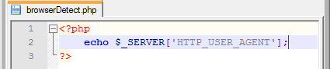
Using PHP to Detect the Browser – Part 1
In order to detect and display the Browser being used you can use the following line of code in your PHP Script:
echo $_SERVER[‘HTTP_USER_AGENT’];
If you use this in a PHP Script such as in the one below then you would get the screens on the next slide:

Slide 3
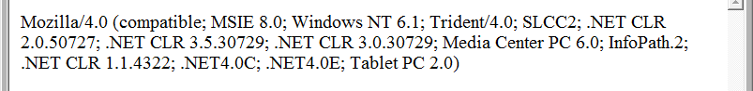
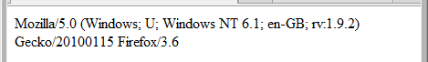
Using PHP to Detect the Browser – Part 2
This is what you would get if you run the script using Microsoft Internet Explorer:
This is what you would get if you run the script using Mozilla Firefox:
The above 2 screenshots are not the most user friendly and they both look very similar!

Slide 4
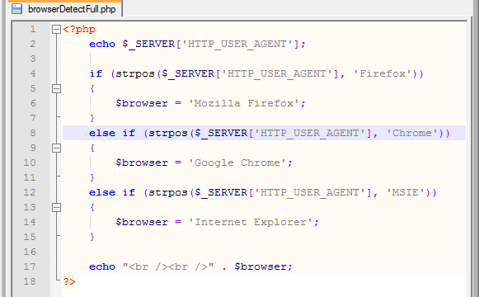
Using PHP to Detect the Browser – Part 3
In order to make the output from our PHP Script more user friendly you could use a series of If statements that would compare $_SERVER[‘HTTP_USER_AGENT’] to a series of values such as below:

Slide 5
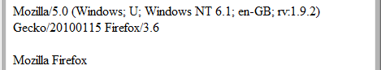
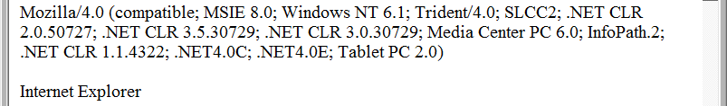

Using PHP to Detect the Browser – Part 4
Using the previous PHP Script in Mozilla Firefox should give you:
Using the Script in Microsoft Internet Explorer should give you:
Using the Script in Google Chrome should give you:

Slide 6
Using PHP to Detect the Screen Resolution – Part 1
After many weeks of searching and researching I still haven’t found an example of a PHP Script that doesn’t use JavaScript for detecting the Screen Resolution
The main reason for this is due to being able to detect the resolution client-side and not server-side
But the good thing is that we can use PHP to output HTML and JavaScript so we will use a PHP Script to generate JavaScript code
On the next slide is an example of a PHP Script that generates JavaScript that will allow us to detect and display the current Screen Resolution

Slide 7
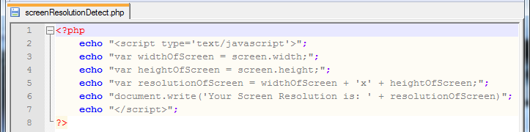
Using PHP to Detect the Screen Resolution – Part 2
The following PHP Script will allow you to detect and display the current Screen Resolution:

Slide 8
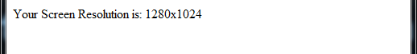
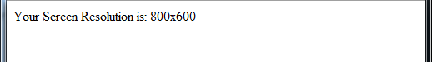
Using PHP to Detect the Screen Resolution – Part 3
Here is what you get if you have a Screen Resolution of 1280x1024:
Here is what you get if you have a Screen Resolution of 800x600:

Slide 9
Exercises
1 – Detecting the Browser
1a) Create a PHP Script that will detect and display the Browser being used
1b) Test your PHP Script in at least 2 different Browsers
2 – Detecting the Screen Resolution
2a) Create a PHP Script that will detect and display the Screen Resolution being used
2b) Test your PHP Script using at least 2 different Screen Resolutions
3 – Find out the meaning and functionality of the following in PHP:
3a) $_SERVER[‘HTTP_USER_AGENT’]
3b) strpos($_SERVER['HTTP_USER_AGENT'], 'Firefox')

